Slide 1
Selection of a café location

Slide 2
Choosing the right place for locating may become crucial for opening a café since it defines visibility and accessibility for potential customers. The importance of a proper location is widely recognized by the business
Data that might contribute to determining café location might include information about attractions in the area, nearby venues, transport accessibility, potential competitors. This project aims to determine a proper area to place a small café in Kiev, Ukraine

Slide 3
Factors that will influence the decision
number of existing cafes in the neighborhood (any type of cafe);
number of and distance to cafes in the neighborhood, if any;
distance of neighborhood from city center.

Slide 4
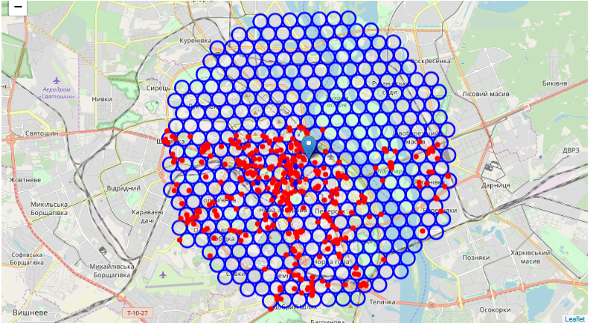
Collected cafes and coffee places on the map of Kiev.

Slide 5
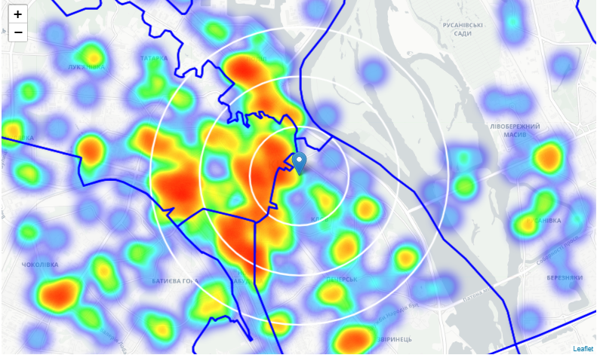
Heatmap of Coffee places in Kiev center

Slide 6
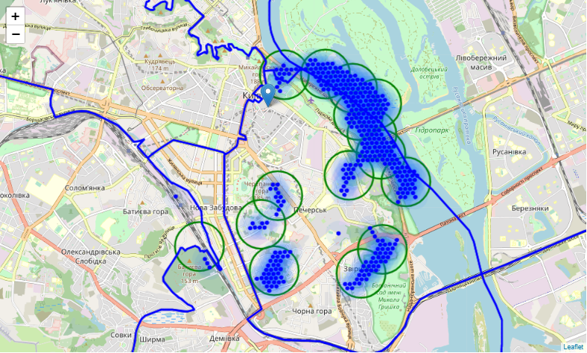
Zones on a city map using shaded areas to indicate the clusters

Slide 7
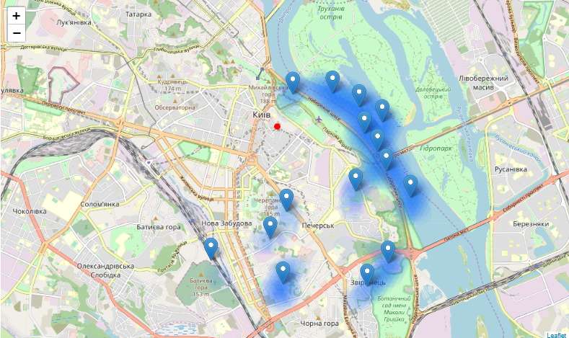
Centers of the zones on a city map

Slide 8
Results and conclusion
Result of all this is 8 (we created 15 but 7 of them are located in or across the Dnieper so we can't consider them) zones containing largest number of potential new cafe locations based on number of and distance to existing venues - both cafes in general and Coffee places particularly
Final decision on optimal cafe location will be made by stakeholders based on specific characteristics of neighborhoods and locations in every recommended zone, taking into consideration additional factors like attractiveness of each location (proximity to park or water), levels of noise / proximity to major roads, real estate availability, prices, social and economic dynamics of every neighborhood etc.

